Slide 1
«Игровые методы и приёмы формирования функциональной грамотности в начальной школе на уроках английского языка»

Slide 3
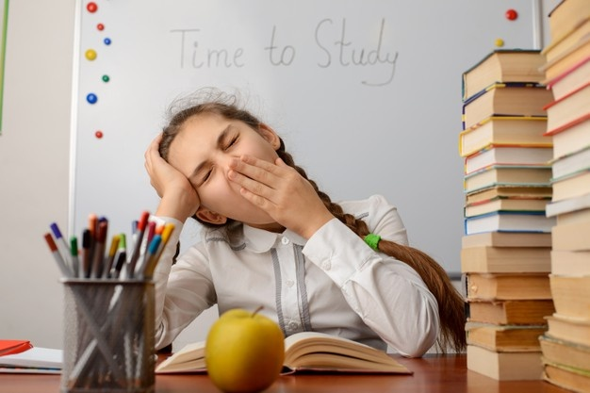
Мотивация Успех

Slide 4
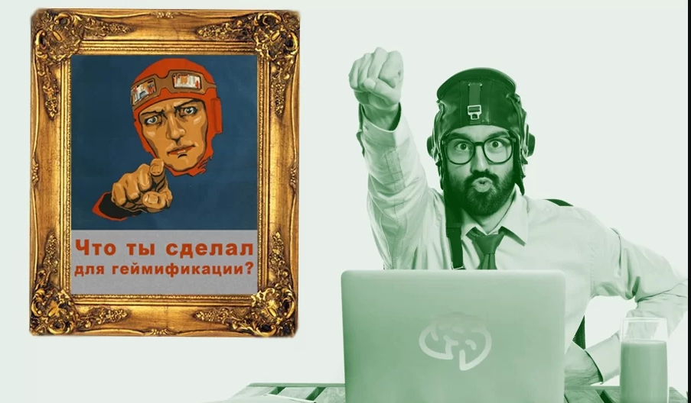
Структура-Позитив-Соревнование-Успех

Slide 5
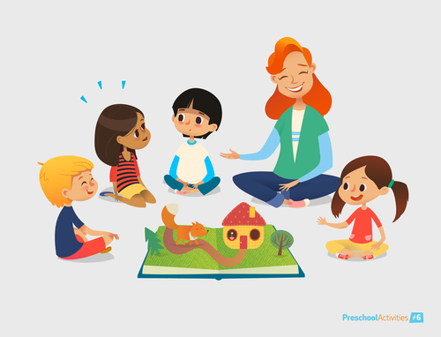
Сторителлинг
Превращаем сухой материал в увлекательную историю!

Slide 6
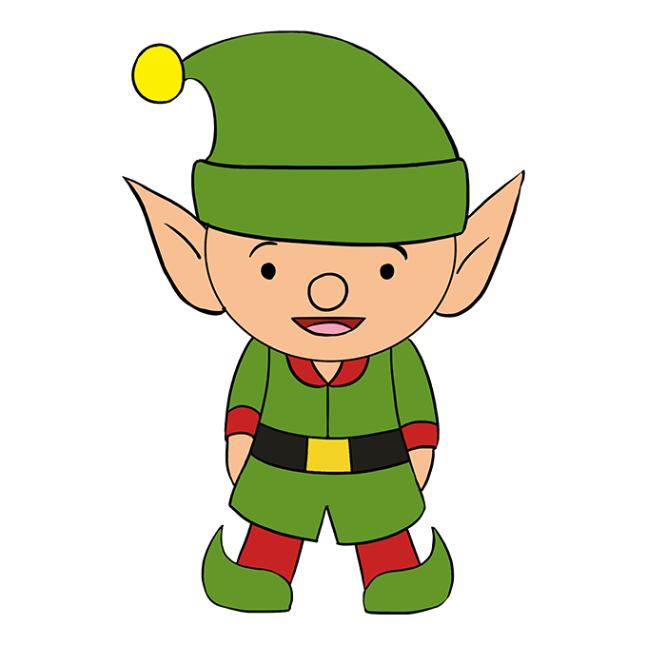
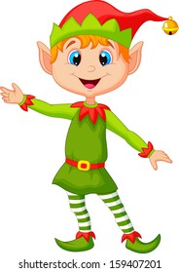
my
his -her

Slide 7
Fill in the pronouns.
1)Mr. Wilson is a teacher.______ pupils are smart. (his/ her/its)
2)The Greens have got three sons.______ sons can swim very well. (his/ our/their)
3) We are friends. _____names are Tom and Tim. (our/ their/ my)
4) Mrs. White has got a pet. _____pet likes to eat chocolate. (its/her/ his/)
5) My name is Mary. ________brother’s name is Mark. (his/my/ her/)
6) Ted and Ben have got bikes._________ bikes are not old. (our/their/ your)
7) My cat is black and slim.____ eyes are green. (his/her/ its)
8) Ann’s father has got a car. _____car is red . (her/his/our)

Slide 8
Квест
Участвуем в увлекательной приключенческой игре!

Slide 9
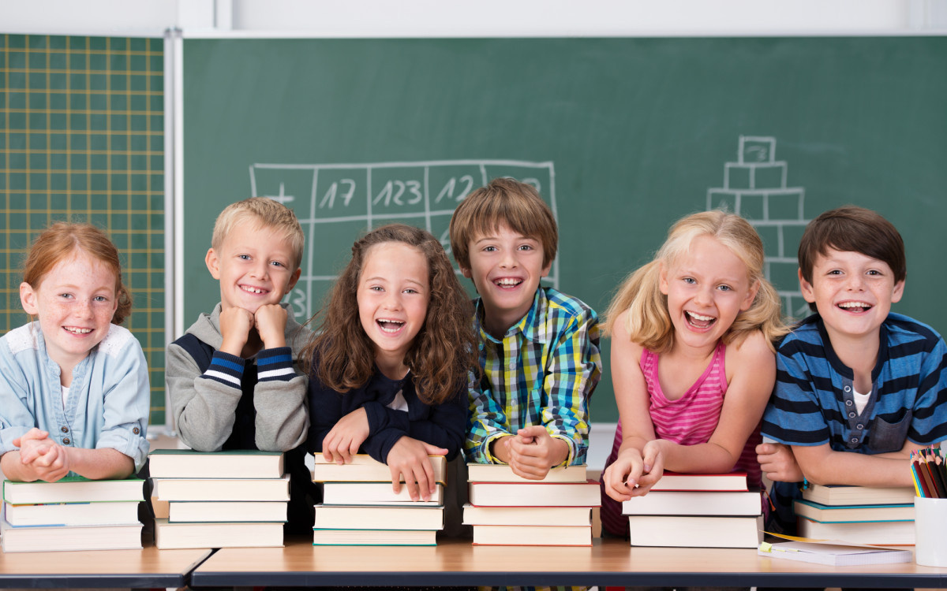
Игровая ситуативность
Используем технологию
ситуативно-игрового подхода

Slide 10
bananas
chips
Ice- cream
?
My favourite food
?
?
- What is your favourite food?

Slide 11
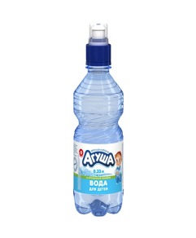
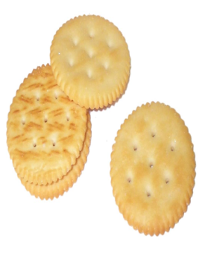
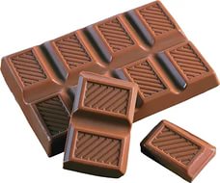
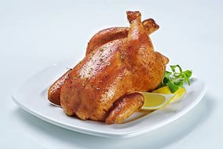
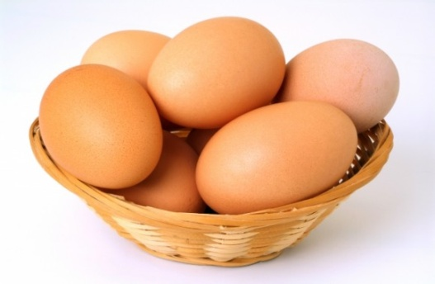
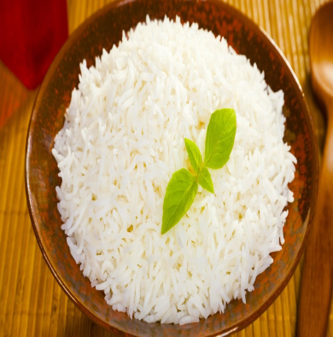
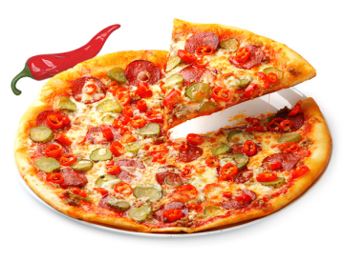
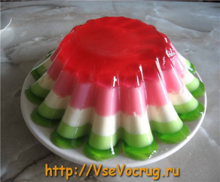
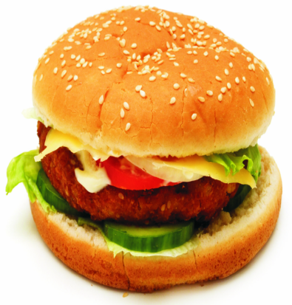
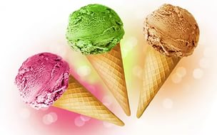
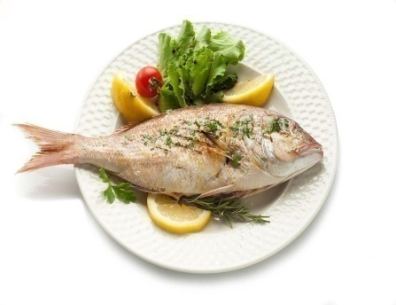
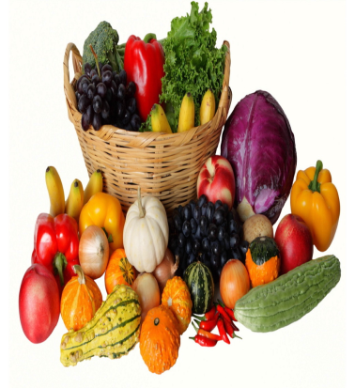
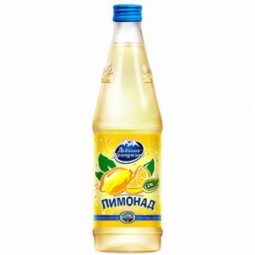
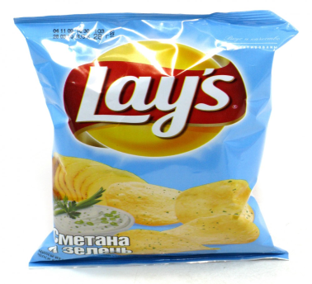
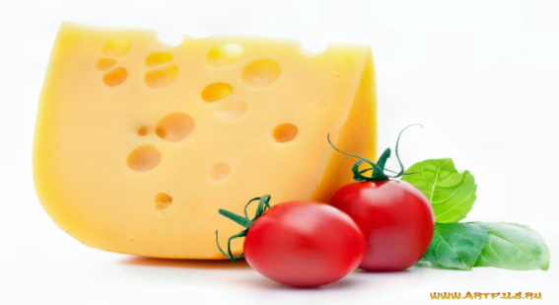
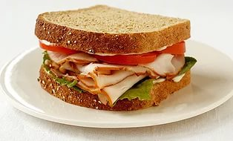
Name the words !
Chicken vegetables eggs burgers
Pizza water cheese fish
Ice- cream lemonade sandwiches rice
Chocolate jelly chips biscuits

Slide 12
Like – нравится, любить
I like -я люблю I don’t like – я не люблю
He likes – он любит He doesn’t like – он не любит
She likes – Она любит She doesn’t like – она не любит
Look and write!
Burgers –V
Eggs - X
Chocolate –V
Lemonade- X
Betty
Bill
Betty likes burgers, but she doesn’t like eggs.

