Slide 1
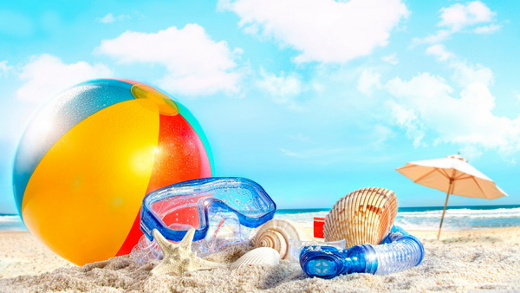
MY SUMMER HOLIDAYS!
Заболотникова К.А.,
учитель английского языка
МБОУ «Лицей №62» г. Кемерово

Slide 2
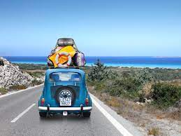
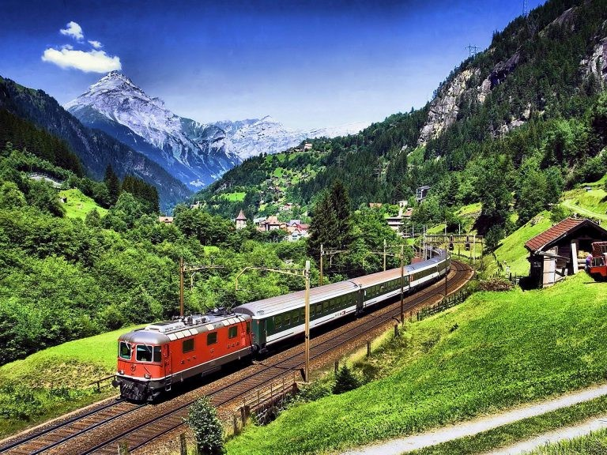
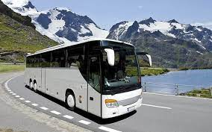
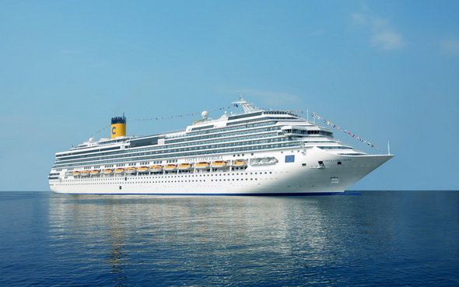
To travel by car/train/plane/bus/ship

Slide 3
To go to the seaside

Slide 4
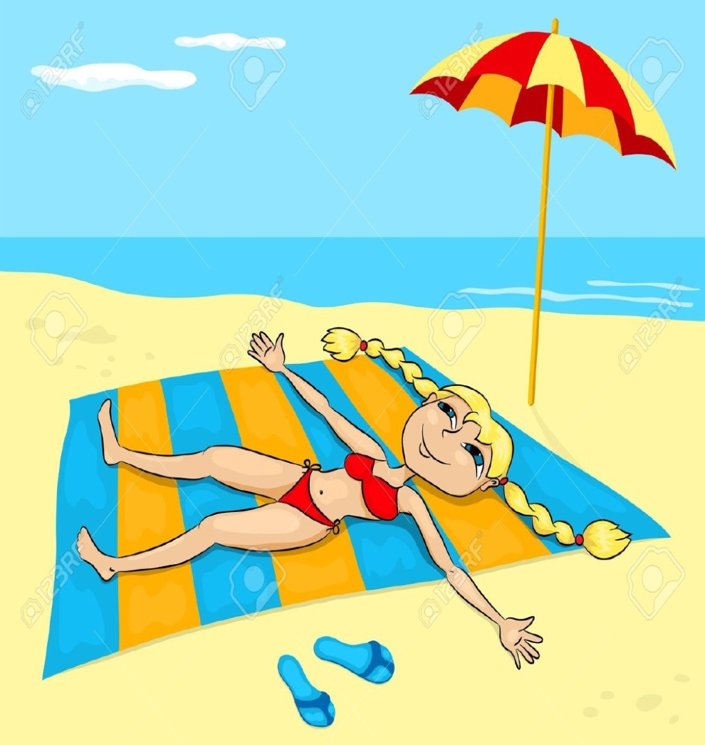
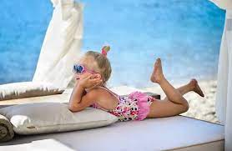
To go sunbathing

Slide 5
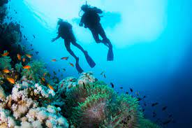
To dive in the sea

Slide 6
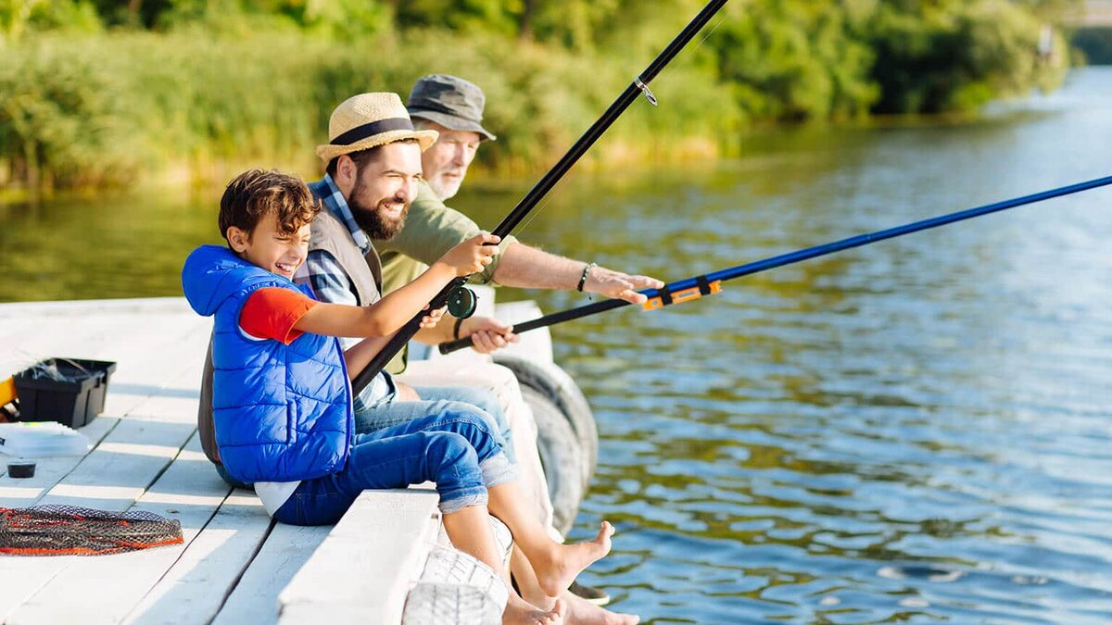
To go fishing

Slide 7
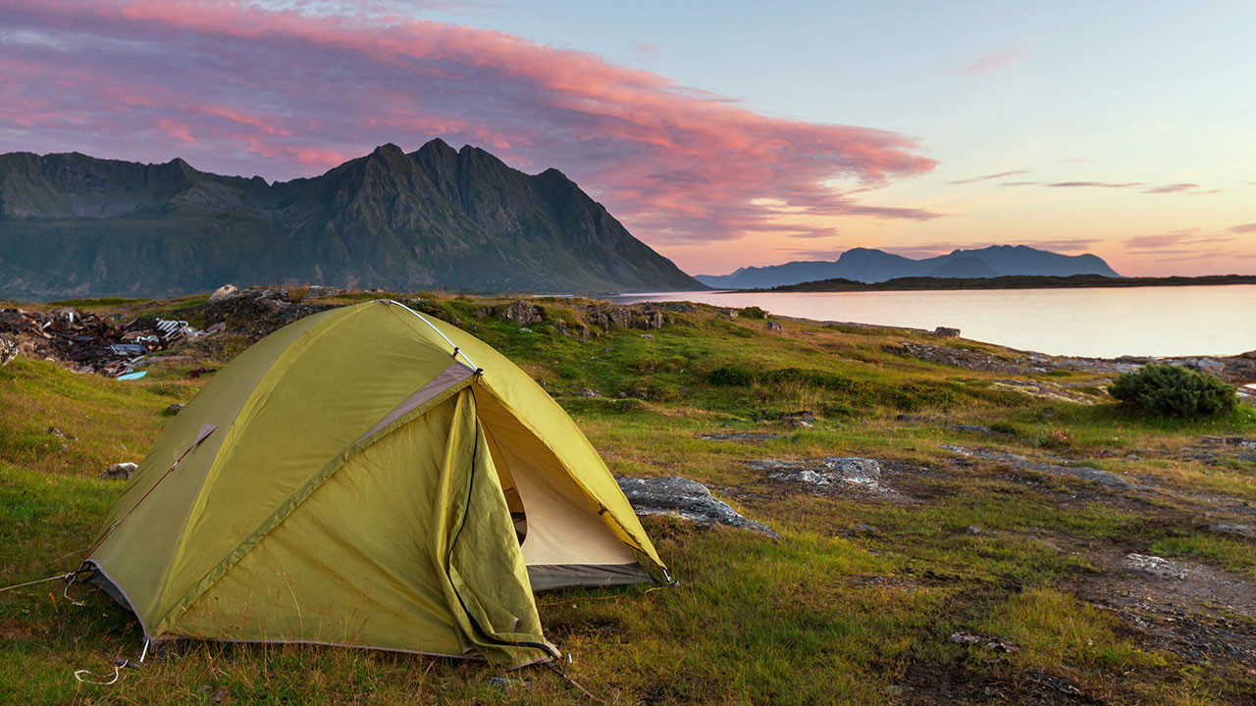
To sleep in a tent

Slide 8
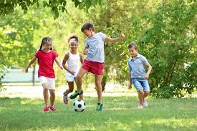
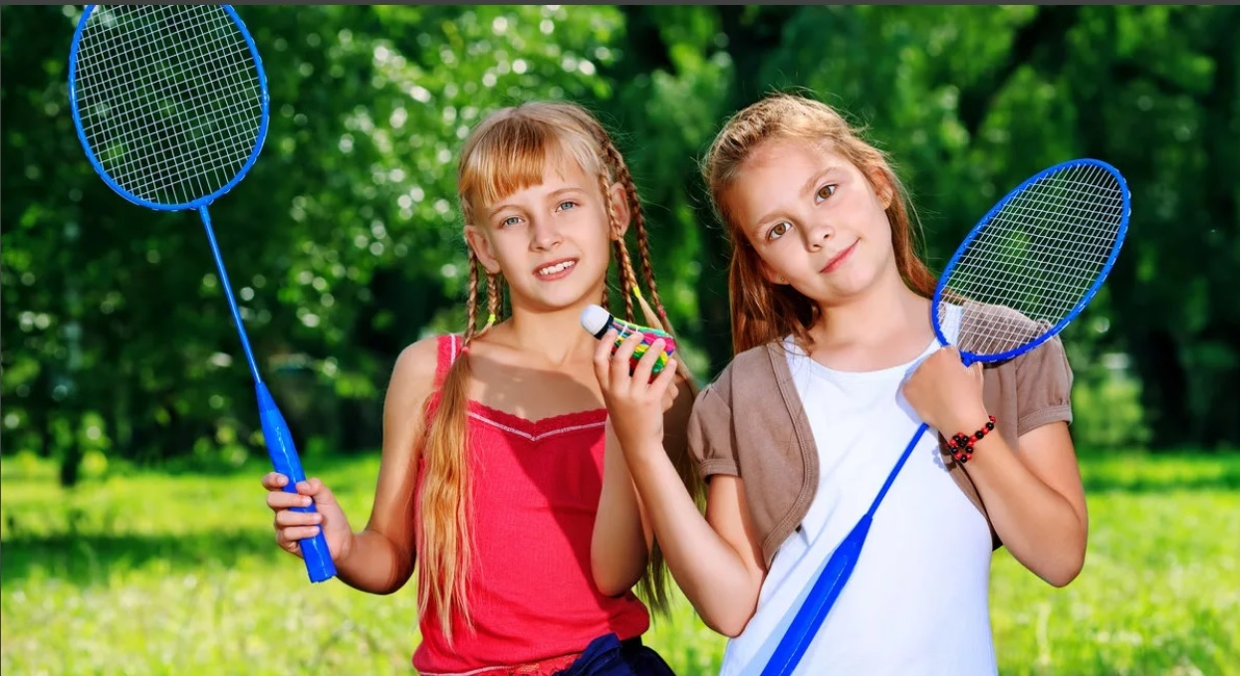
To play sport games

Slide 9
To read books

Slide 10
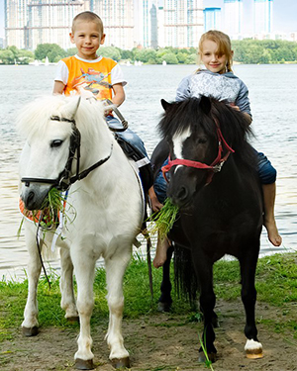
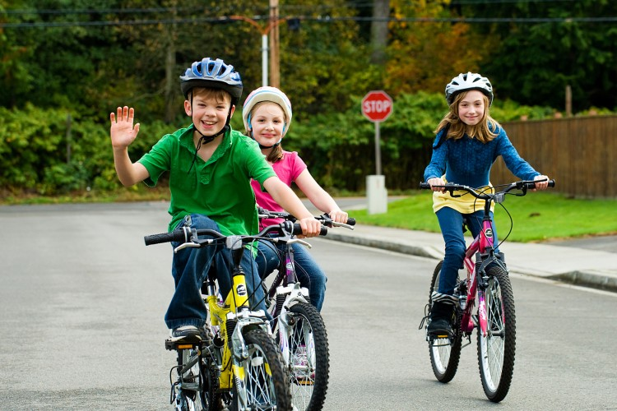
To ride a bicycle/a horse

Slide 11
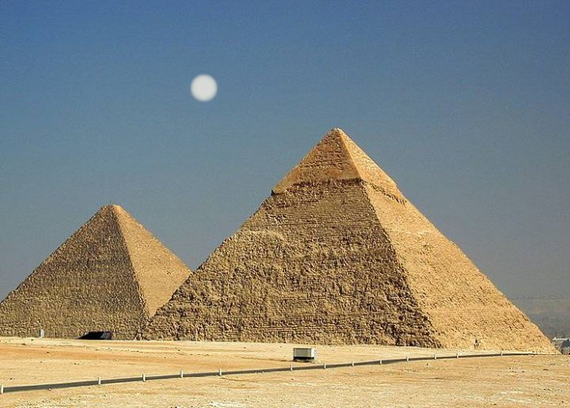
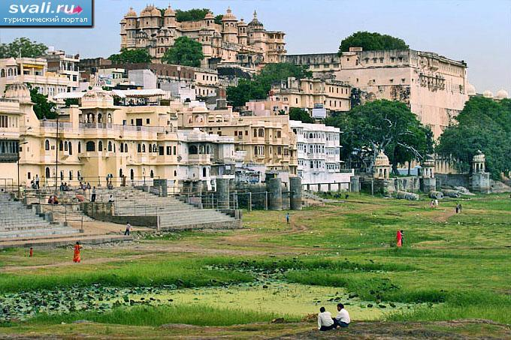
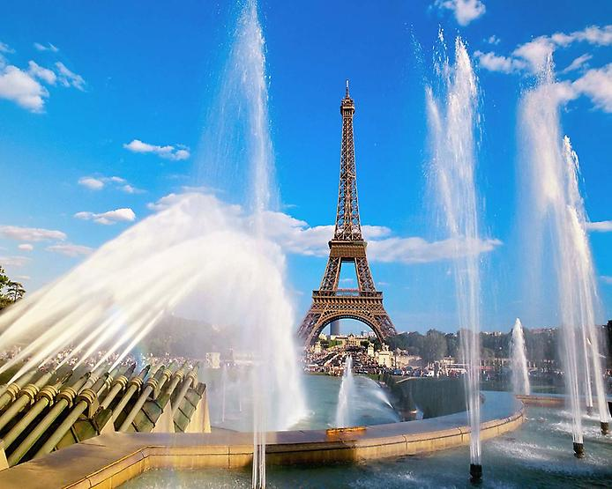
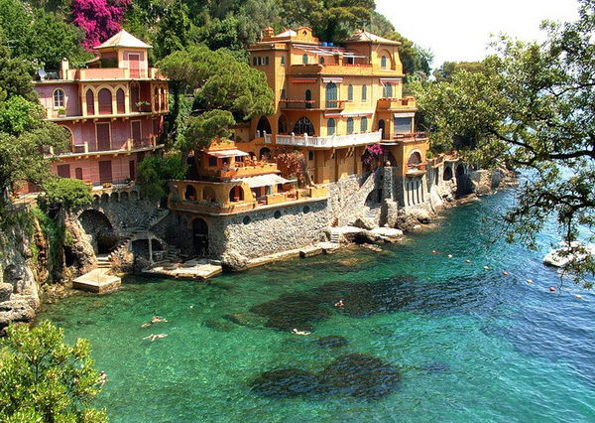
To visit new places

Slide 12
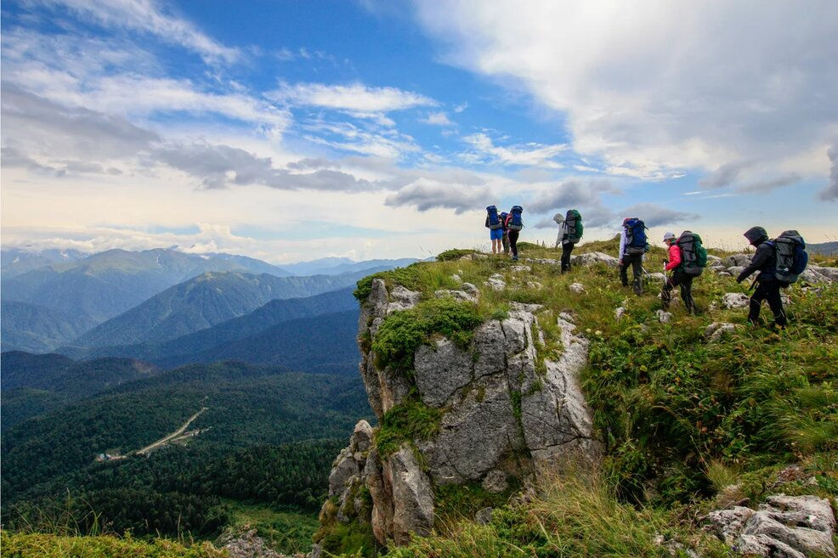
To climb mountains

Slide 13
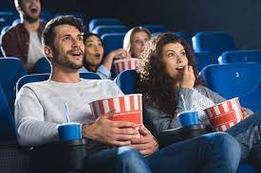
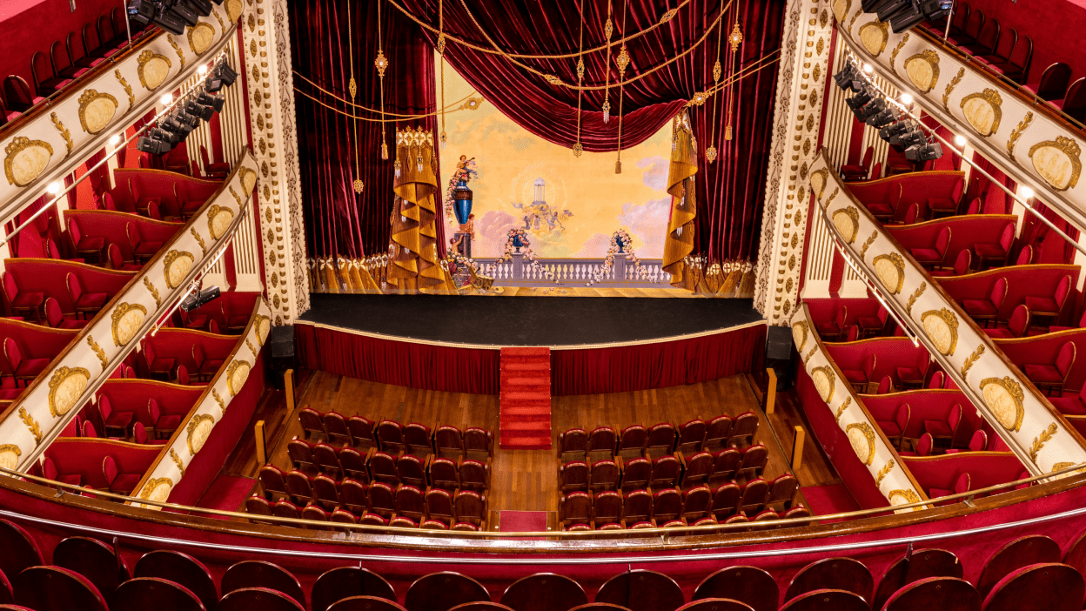
To go to the cinema /to the theatre

Slide 14
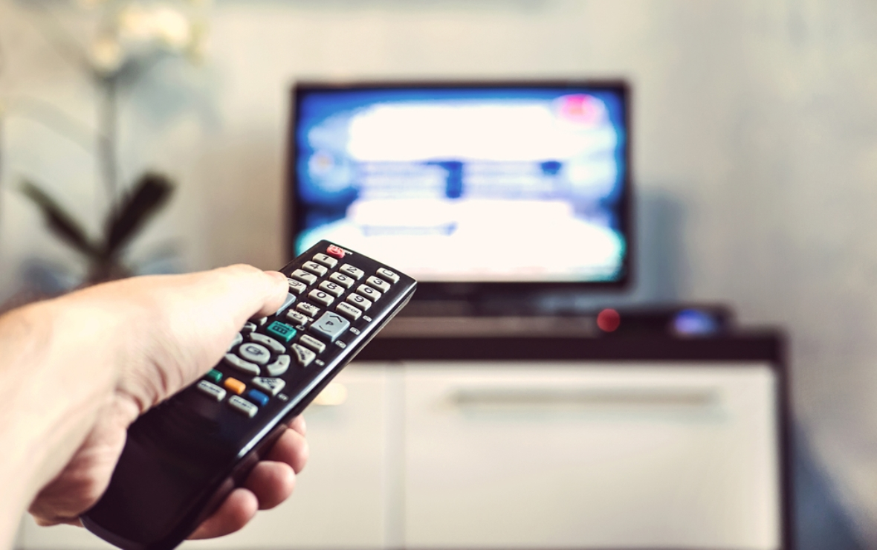
To watch TV

Slide 15
exciting
wonderful
useful
dull
nice
quiet
pleasant
funny
My holidays were
amazing
marvelous
cool
boring
unforgettable
interesting
super
adventurous
terrible
remarkable
magnificent

Slide 16
Put the sentences in the correct order to make the conversation
Kelly: How do get there?
Meg: I like to swim in the sea and go fishing.
Meg: We always go to the seaside by train.
Kelly: Meg, why do you like summer holidays?
Meg: I like summer holidays because I can go to the seaside with my brother.
Kelly: What do you usually do at the seaside?
Make up your own sentences
I go fishing in summer
We go to the seaside in the sea
I like to swim at the seaside
I spend my holidays by car
I like to sunbathe in the country

