Slide 1
Aa
[æ]|

Slide 2
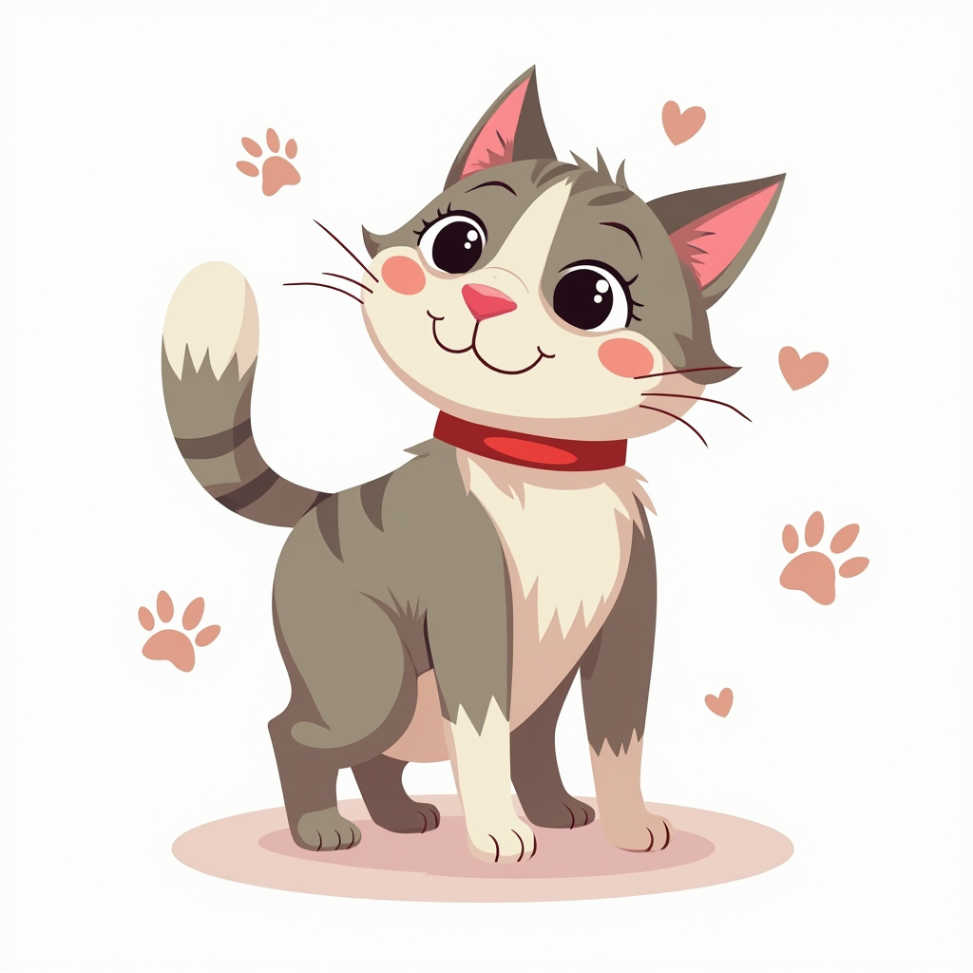
cat
[æ]|

Slide 3
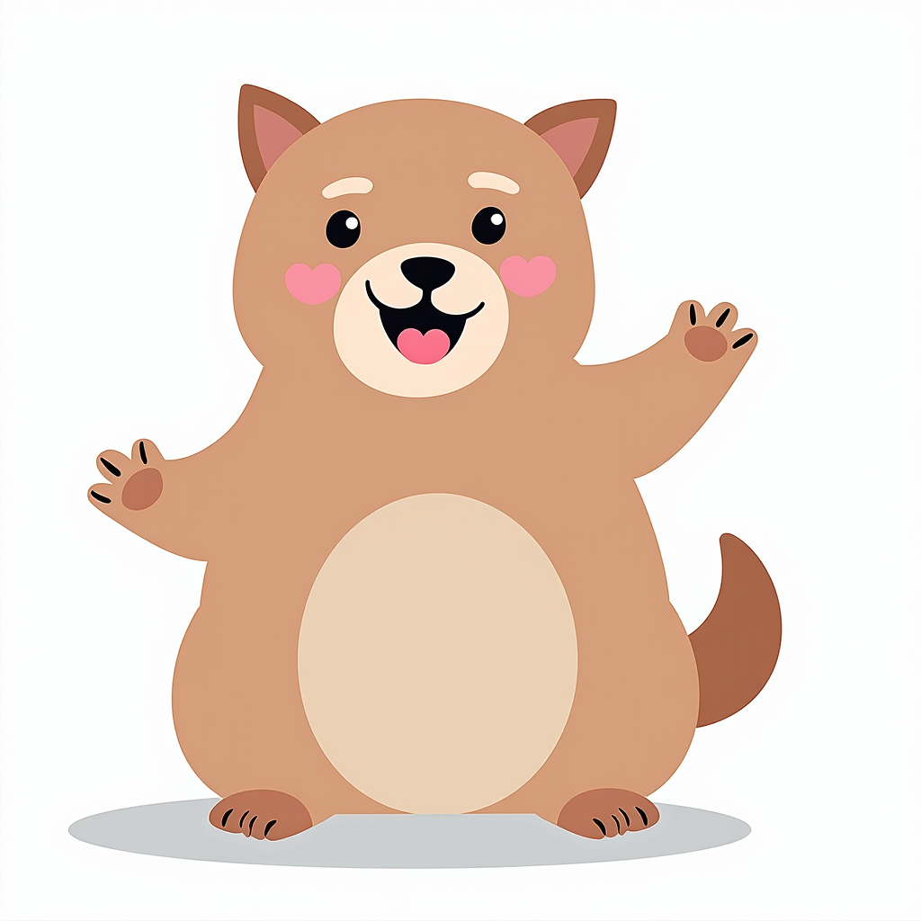
fat
[æ]|

Slide 4

hat
[æ]|

Slide 5
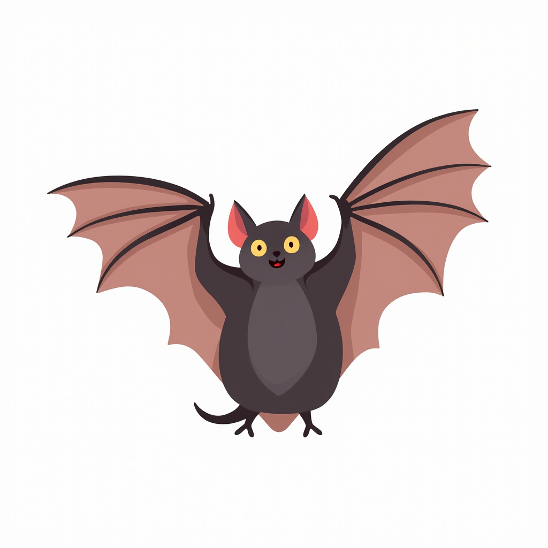
bat
[æ]|

Slide 6

cap
[æ]|

Slide 7

black
[æ]|

Slide 8
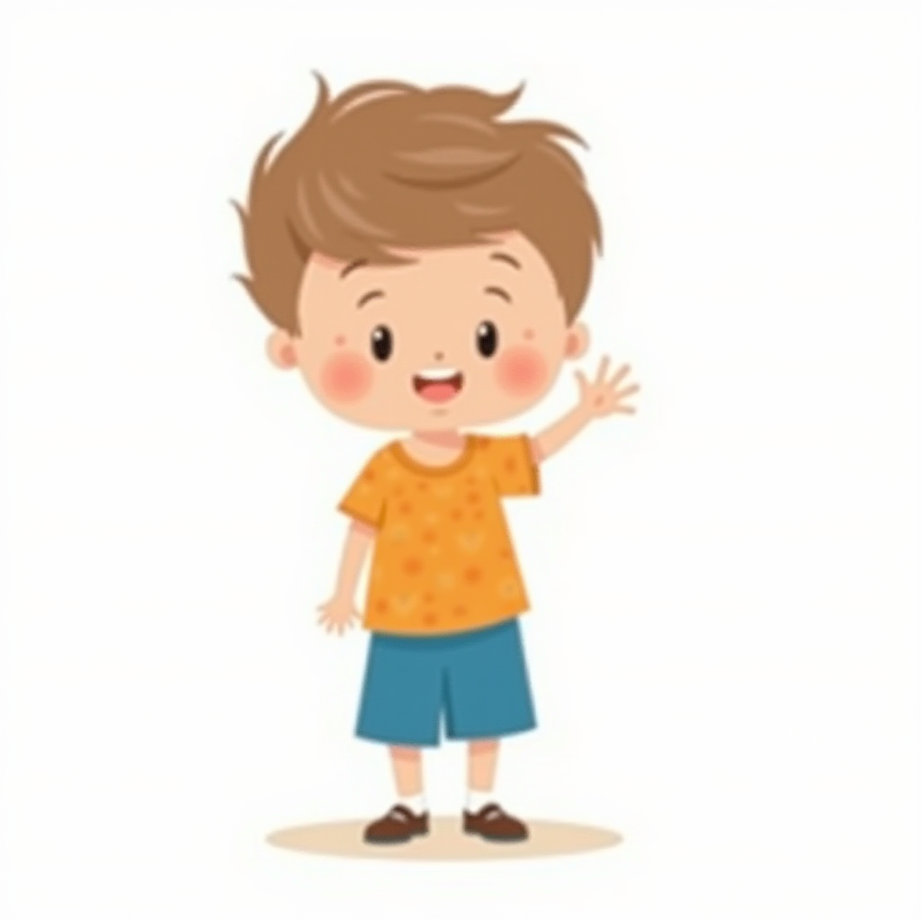
hand
[æ]|

Slide 9
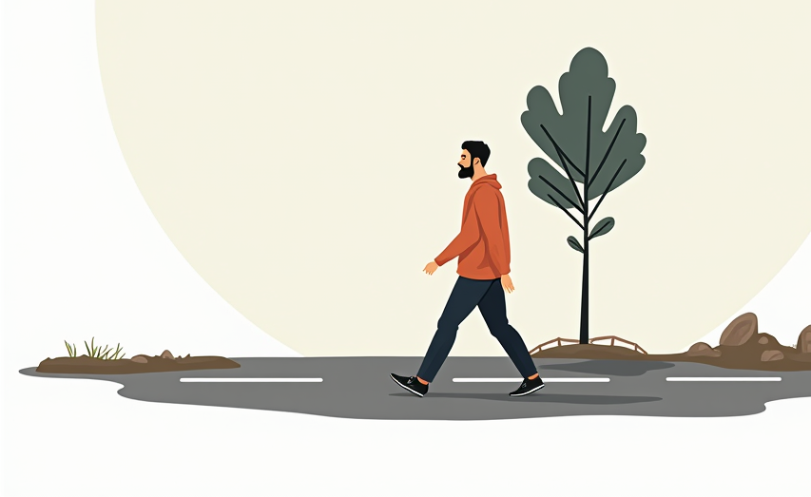
man
[æ]|

Slide 10
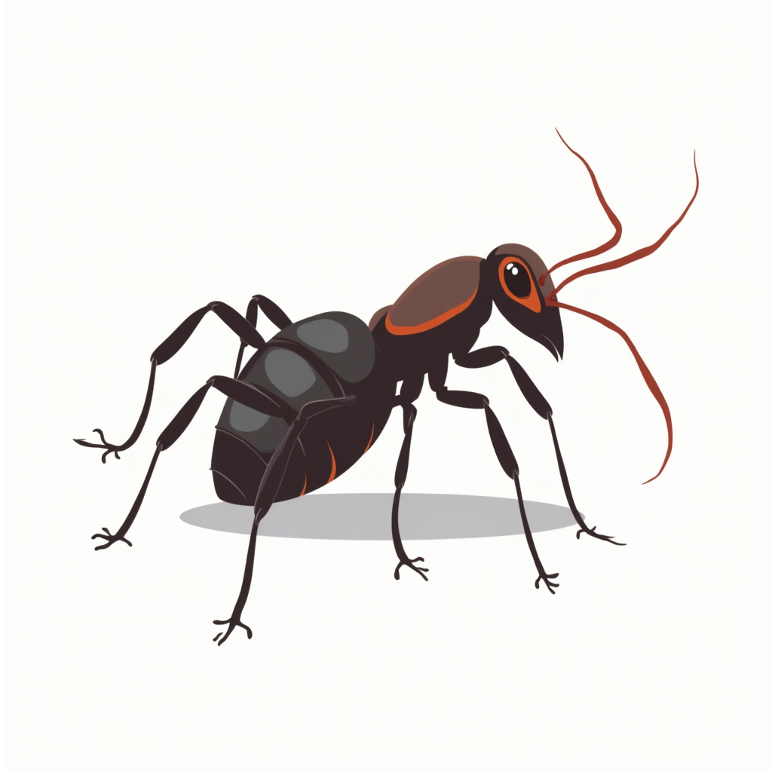
ant
[æ]|

Slide 11
can
Dan and have has
Pam
[æ]|
[æ]|

Slide 12
Aa
[eɪ]|

Slide 13
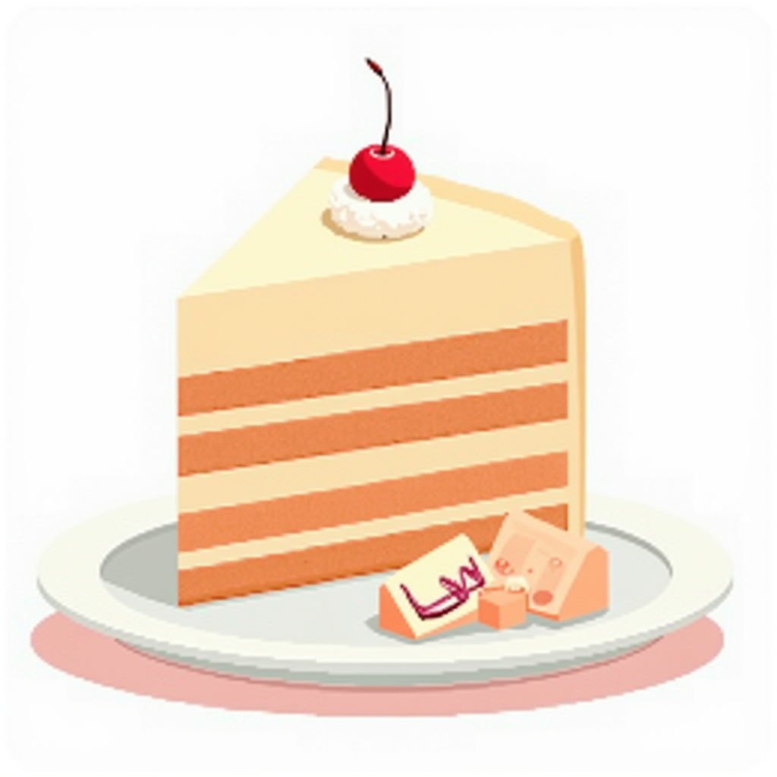
cake
[eɪ]

Slide 14
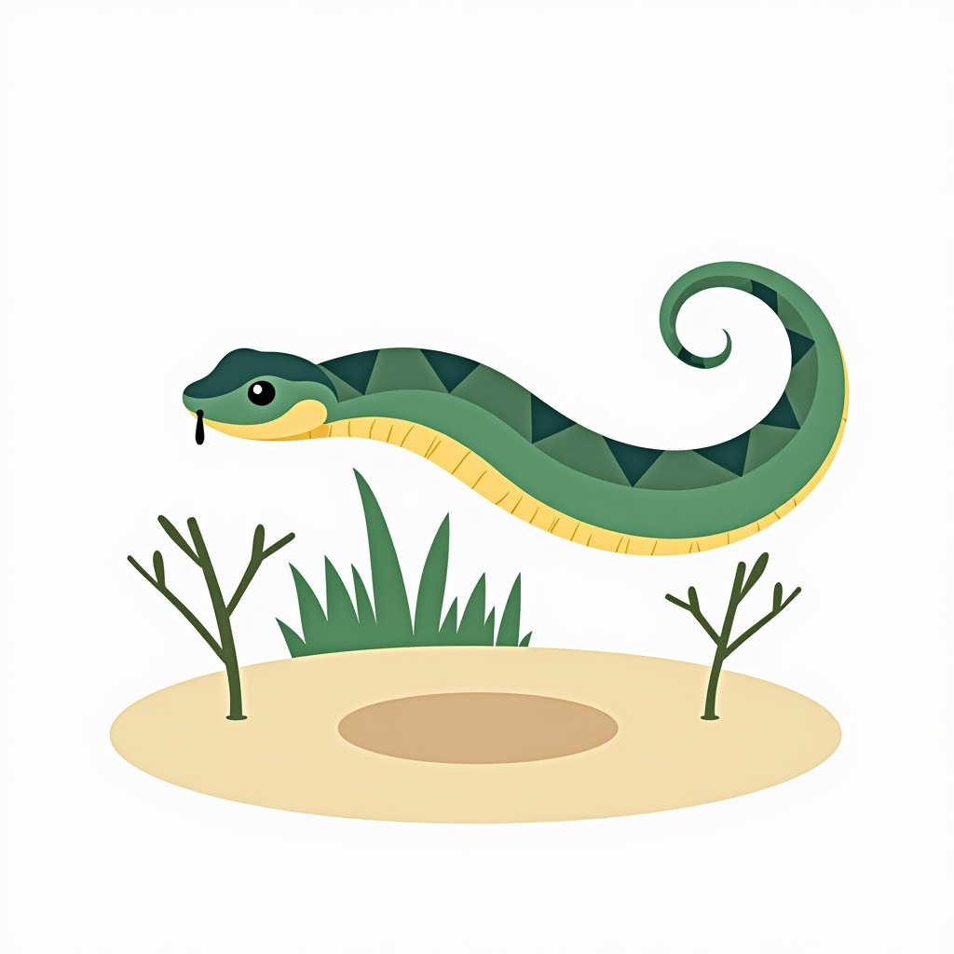
snake
[eɪ]

Slide 15

lake
[eɪ]

Slide 16
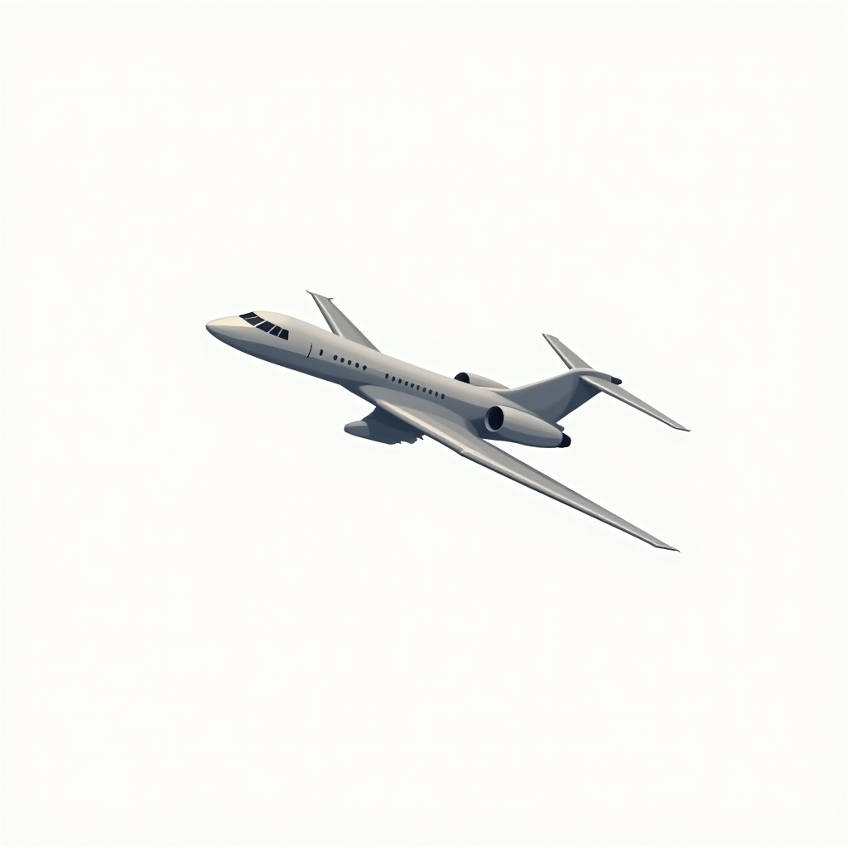
plane
[eɪ]

Slide 17
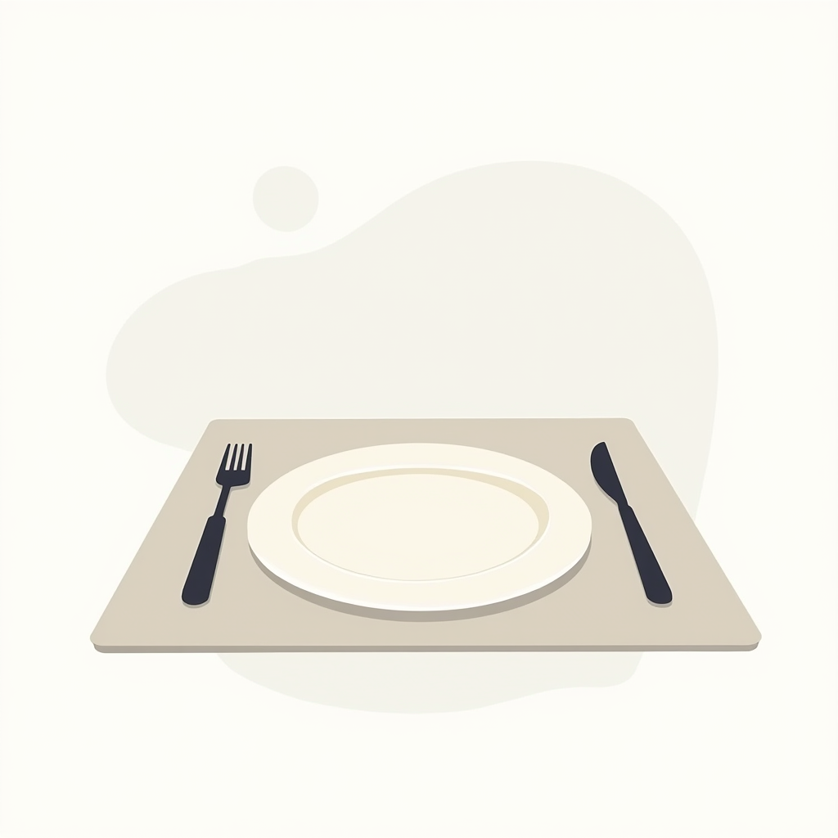
plate
[eɪ]

Slide 18
Jane
Name
Dave
[eɪ]

Slide 19
Все картинки сгенерированы нейросетью

