Slide 1
My pet
(Spotlight 5 Module 5)
Учитель: Заболотникова К.А.
МБОУ «Лицей №62» г.Кемерово

Slide 2
My cat is black
My cat is fat
My cat likes rats
Rats are fat

Slide 3
Goals
read and understand information about pets
listen and understand information about pets
talk about pets

Slide 4
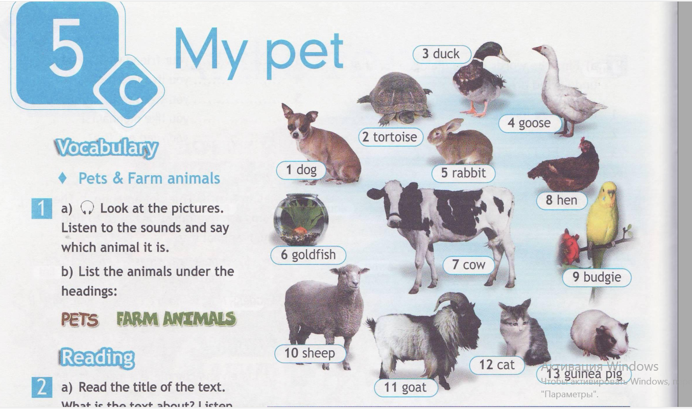

Slide 5
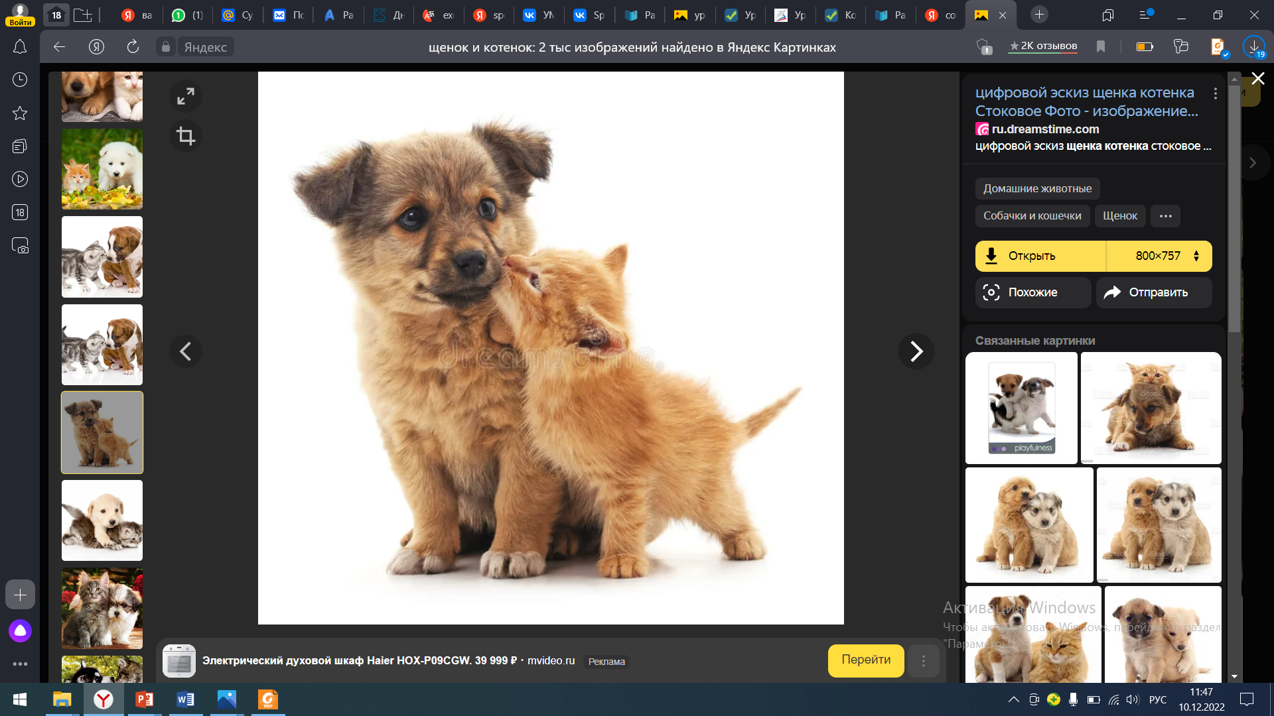
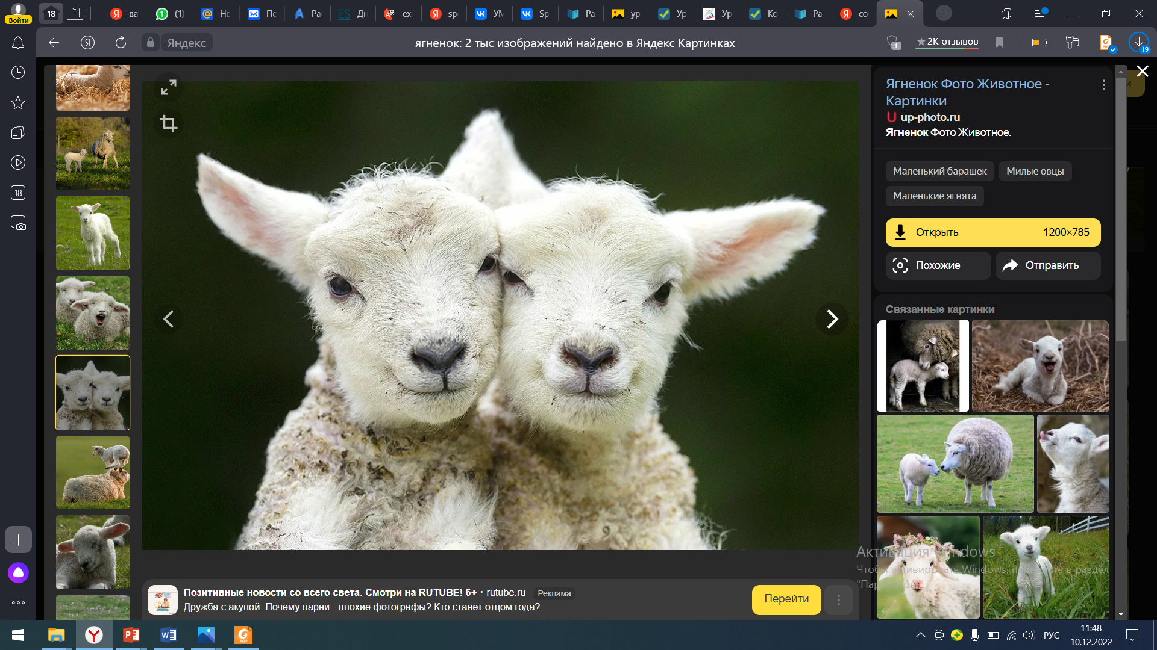
Pets | Farm animals animals

Slide 6
Pets | Farm animals
Dog | Duck
Budgie ['bʌdʒɪ] | Goose
Cat | Hen
Tortoise ['tɔ:təs] | Cow
goldfish | Sheep
Guinea pig ['gɪnɪpɪg] | Goat [gəut]
Rabbit | Rabbit

Slide 7
Let`s guess the riddles. You should guess what animal it is.
Read the description of an animal .
This animal`s got a big body and lives on a farm. It can run but it can`t jump.
It`s got horns (рога) on it`s head.
It`s got green feathers (перья). It lives in the house.
It`s a small animal with a round body. It`s got a small head. It can`t run.
It`s got short fur (мех) and long ears. It can`t run. It can only jump.
It`s got feathers (перья) and wings (крылья). It lives on a farm.

Slide 8
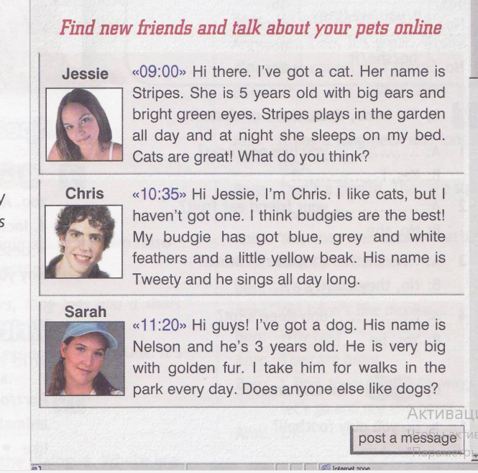
Listening
What do you know about Jessie’s pet?
What can you say about Chris’s pet?
What can you say about Sarah’s pet?

Slide 9
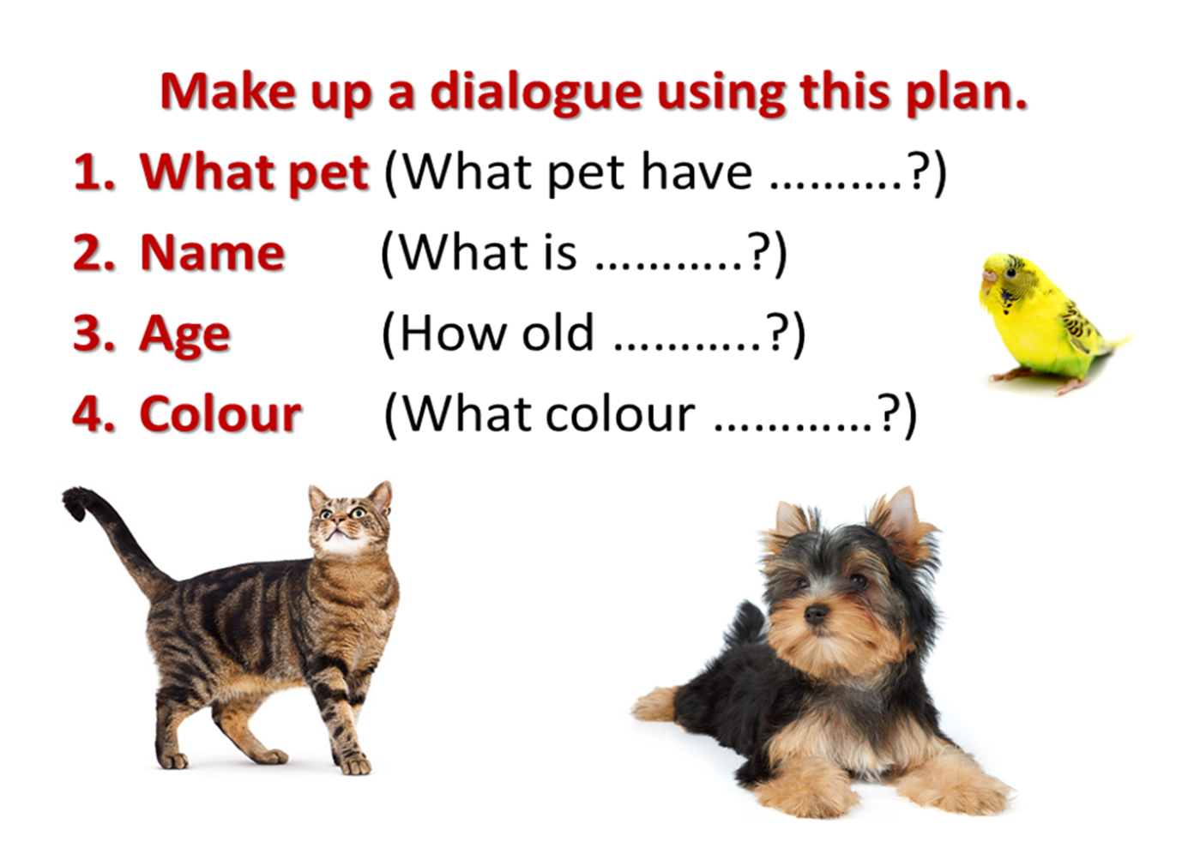
Work in pairs

Slide 10
Speaking
What pet have you got? I’ve got a …
What is his/her name? His/Her name is ….
How old is ….? He/She is … years old.
What can your…..? He/She can…
Why do you like…? I like my… because he/she is funny/playful/….

Slide 11
Your home task for the next lesson: write a message about your pet.
Thank you!

