Slide 1
What time is it?
Который час?
Spotlight 5 Module 6

Slide 2
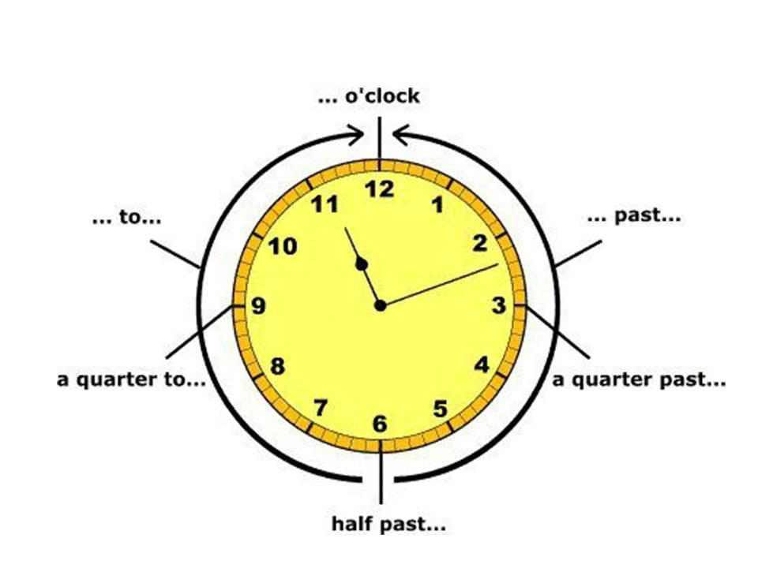

Slide 3
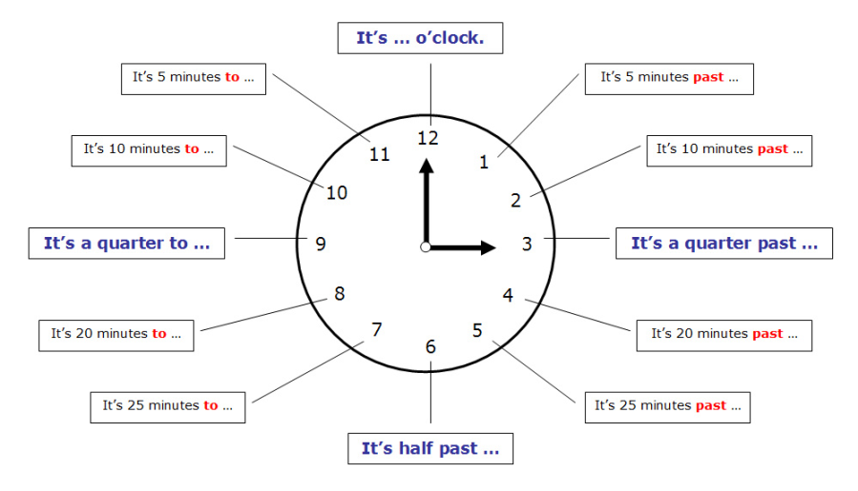

Slide 4
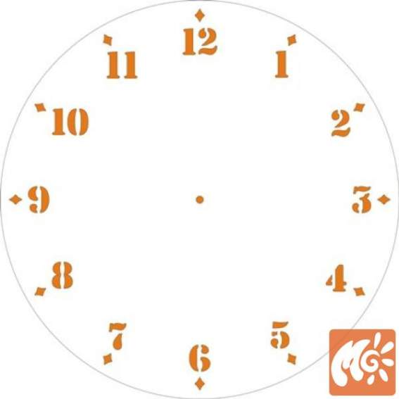
It’s nine o’clock.

Slide 5
It’s a quarter past six.

Slide 6
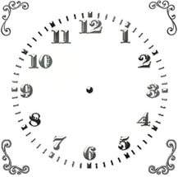
It’s twenty past seven.

Slide 7
It’s ten to two.

Slide 8
It’s half to twelve.

Slide 9
It’s a quarter to three.

Slide 10
It’s twenty- five past one.

Slide 11
It’s twenty- five to six.

