Slide 1
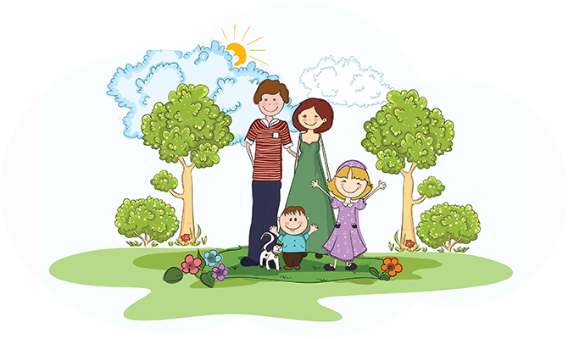
Who is who?
Module 1

Slide 2
Translate
Bill is Tom’s grandson.
Gill and Johnny are Beth’s grandchildren.
Kim and Kate are twins.
I love all my relatives.
Mike is married to Janet.
Grandparents are in their late sixties.
Sam is in his mid forties.
Bill has got two cousins.
Mike is Janet’s husband.
Sue is Sam’s wife.

Slide 3
Describe their appearance

Slide 4
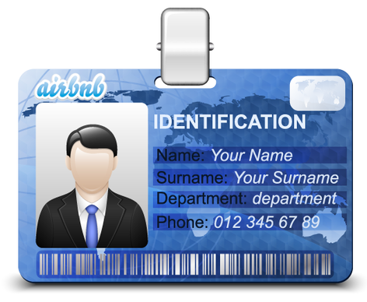
Ask personal questions
_____? I’m Bill Phelps.
_____? 15, Lake Street, London.
_____? I’m 35.
_____? I’m Irish.
_____? B-I-double L P-H-E-L-P-S.
_____? I’m from Ireland.
_____? 54667012

Slide 5
Finish the sentences with: slim, twins, spell, middle, wavy, late, nationalities
Mike‘s hair is short and ____.
His sisters are _____.
His father is a ______-aged man.
My grandparents are in their ____ sixties.
Susan is tall and ____.
In Russia there are a lot of ______.
How do you ____ your surname?
Use the right pronoun:
Their/theirs flat is modern.
Liz has got a new house. Her/our house is spacious.
Is Nick your/yours brother?
Are these notebooks her/hers?
This camera isn’t mine/my.
6. This little kitten is our/ours.
7. Ben and Joan are my/mine friends.
8. What is his/hers address?
9. What’s your/her phone number?
10. Is this ball his/her?

Slide 6
I Russia
My name is ____. I’m from ____. I live in Western Siberia, it’s in the north of Russia.
My country is large____ and _____. There are _____seas and _____ rivers, plains and mountains in it.
Tourists come to Russia to see _____.
Russia is a wonderful place to live.

Slide 7
Finish the sentences
Spanish live in … The sun sets in the … Western Siberia is in the … Russia is a wonderful place to live and … People in Germany speak … The Black Sea is in the … There are deserts and mountains in … | -west. -German. -Chile. -north. -visit. -south. -Spain.

Slide 8
The UK
There are four parts in the UK: … .
The capital city of England/Scotland/ Wales/ Northern Ireland is … .
About … people live in the UK.
The UK flag is named … .
The UK money is named ... .

Slide 10
Make up sentences
myself/me/let/introduce
to/my/aunt/I’d like/you/introduce
you/to/pleased/meet
are/you/how/?
the Earth/continents/are/there/six/on
on/four/are/oceans/the Earth/there
over/people/population/the world/billion/ is/seven
years/billion/the Earth/old/4.5/is

Slide 11
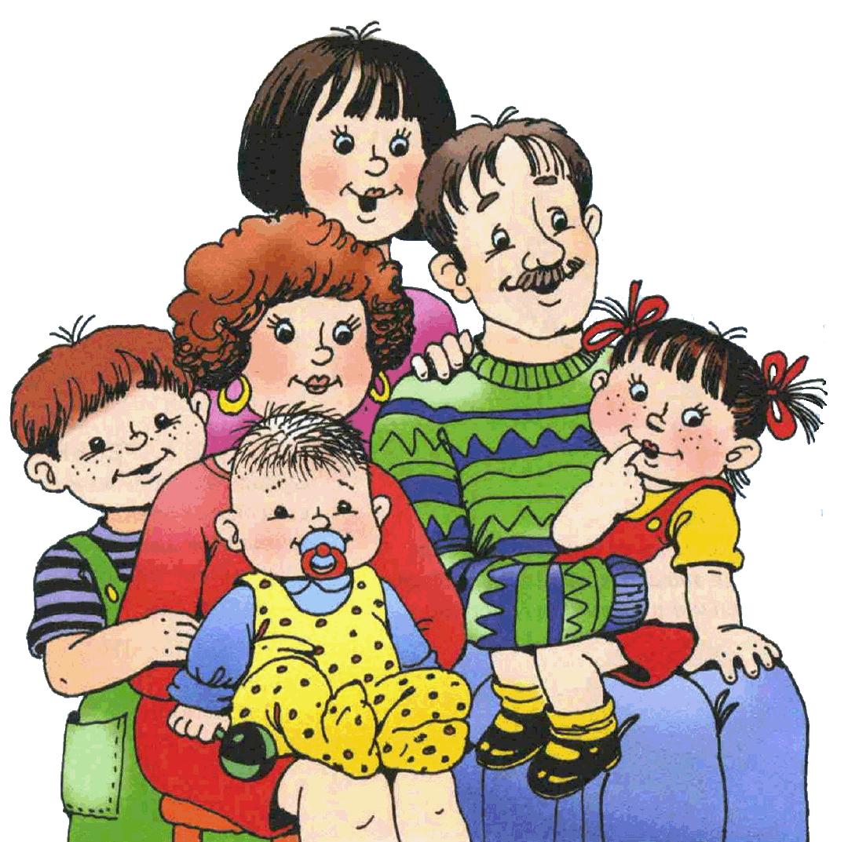
Let me introduce my family
My family is quite large/small. All together there are ____ people in my family.
We live in a(n) flat (apartment)/house.
My parents both work. My _____ look(s) after me. I help them around the house.
We have a lot of fun together. In winter we _____. In warm weather we spend much time outdoors. We _____.

