Slide 1
Verbs

Slide 2
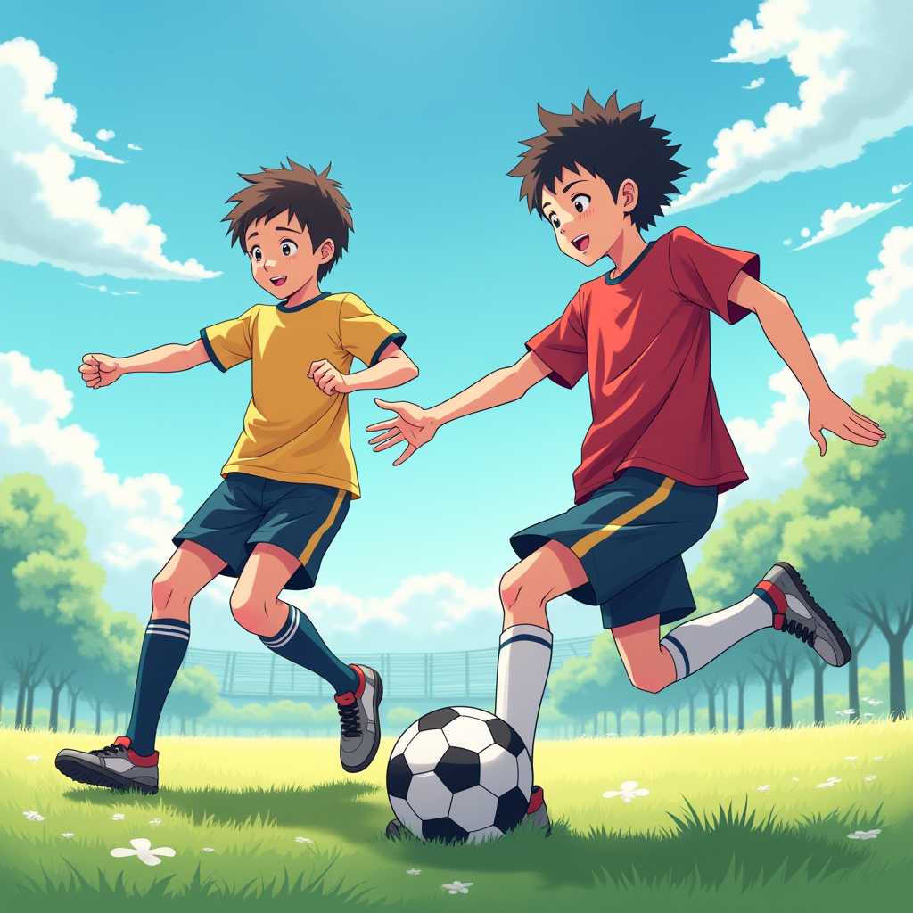
play

Slide 3

listen to music

Slide 4
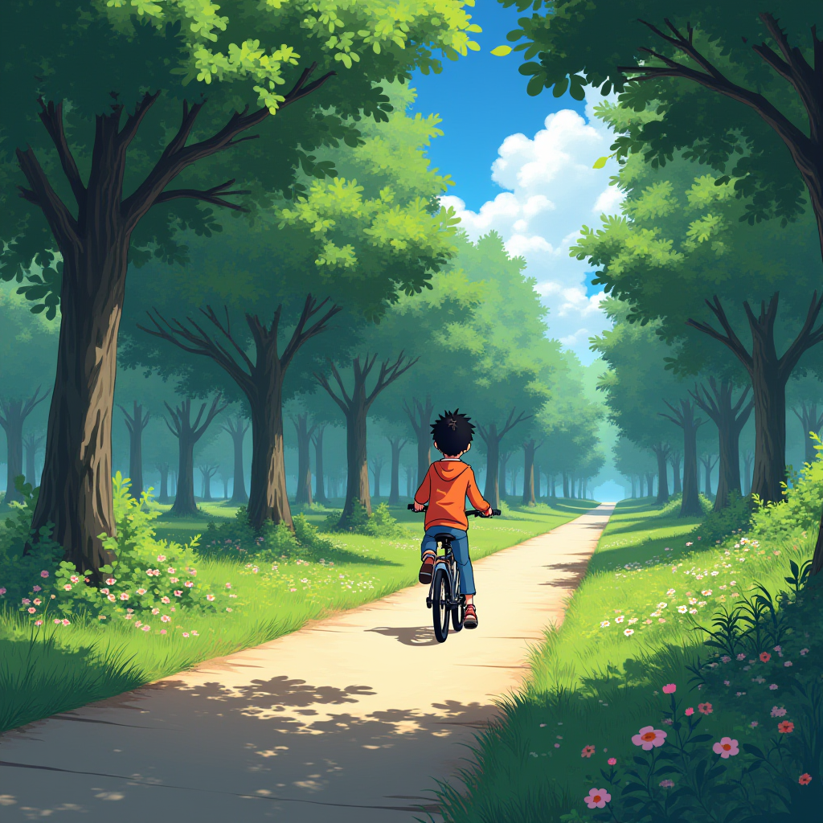
ride a bicycle

Slide 5
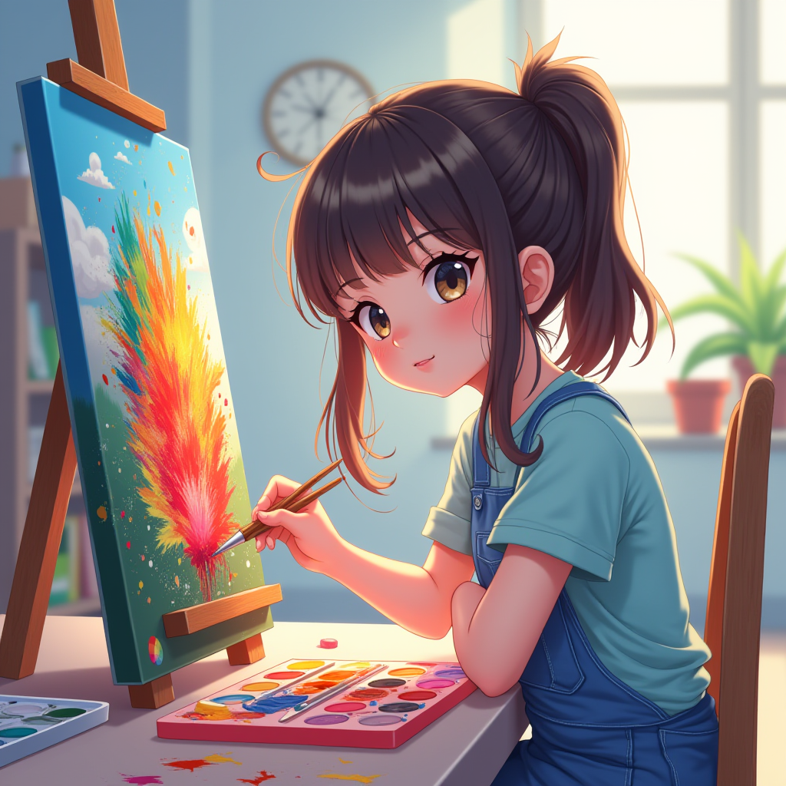
paint

Slide 6

jump

Slide 7

draw

Slide 8
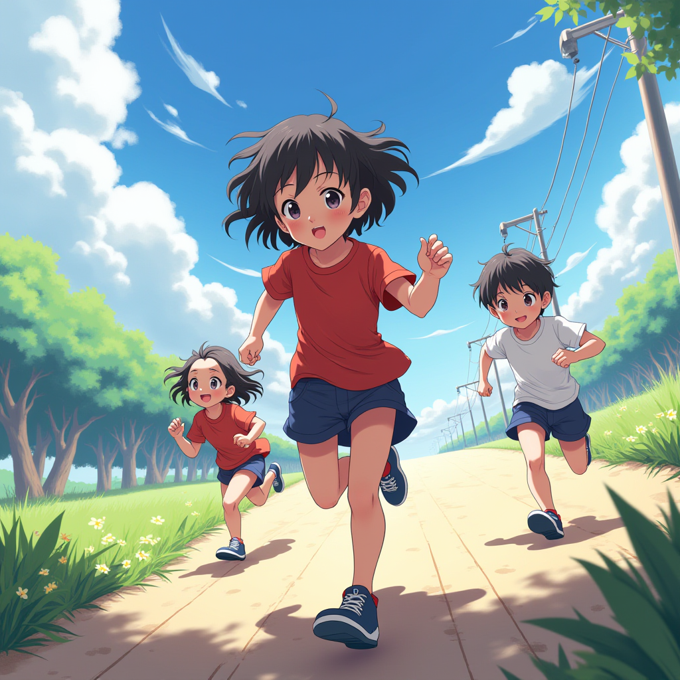
run

Slide 9

read

Slide 10

write

Slide 11
Сгенерированы картинки нейросетью https://robotext.io/image

